Slide 1
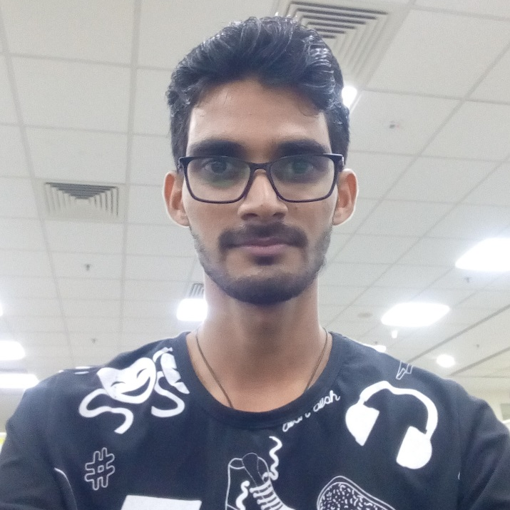
Hello Guys
Dhiraj Mhatre,
Working in Kotak since 2015
Key Focus Area :
KS-API Documentation
KS-API Development
L2 Technical Support
Admin Website
Dhiraj Mhatre
Software Engineer

Slide 2
Key Responsibilities
Key responsibility to develop and maintain APIs.
Miscellaneous Application
API Devlopment
Refer & Earn
Forgot Password Changes
API development for applications like KEAT, KST, KS-Dealer, Fastlane etc.
Documentation for KS-API
Provide APIs for refer & Earn projects
Connects with LMS system to check and update referral data.
Develop Web Page to check Shared Memory details like Client details and Scrip details
This helps support team to resolve Shared Memory related issues quickly.
Integration of OTP facility along with traditional Question/Answer facility .

Slide 3
Change Makes the Difference
Key areas needs to be looked at in near Future
Integration of APIs
Integration of existing APIs in Industry Standard JSon format
Service related APIs (One View)
Connector
Minimize repetitive queries
By providing proper documentation to L1 Support Team

Slide 4
Get in Touch
dhiraj.mhatre@kotak.com
9604890225
Goregaon ,
Infinity IT Park
Thank you.

